Slide 1
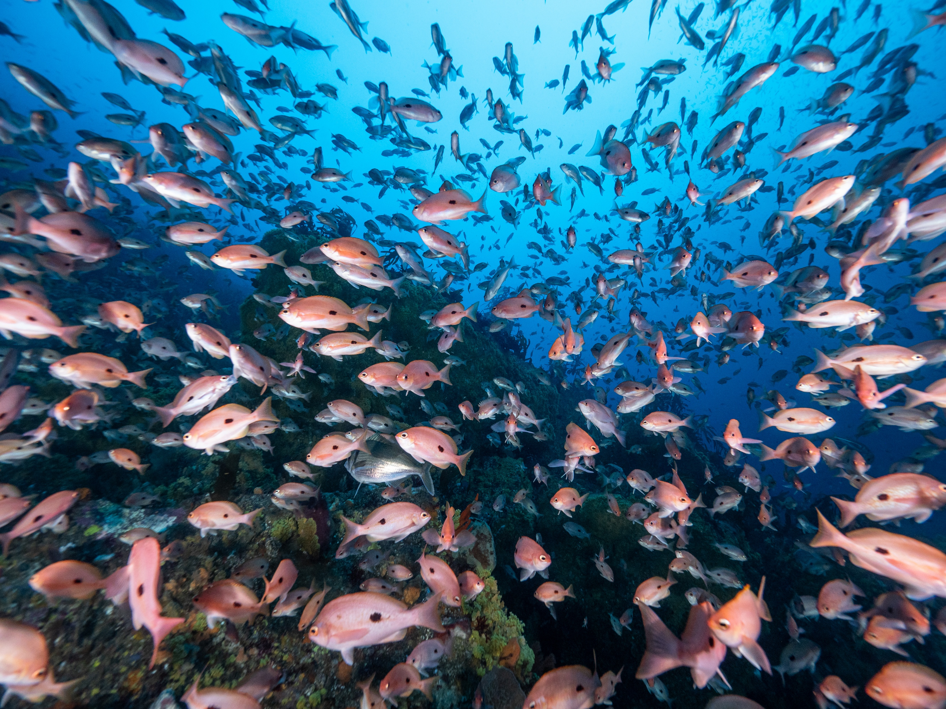

Lesson plan: Resilient ecosystems
Teacher Resources linked to the Big Fish card game
All photography in the document is by Matt Testoni and should only be used for teaching purposes as intended here
Resource development supported by Inspiring Australia Tasmania

Slide 2
Australian Science Curriculum
Year 9 Outcomes:
This lesson targets the Biological Sciences focus on interdependence and interactions within ecosystems and how biological systems respond to change.
ACSSU176 “Ecosystems consist of communities of interdependent organisms… matter and energy flow…”
Science Inquiry (collecting/analysing data from a model): understanding how our environment changes with changing climactic conditions and the ways in which we can best adapt and prepare our ecosystems for these changes.
AC9S9I01–AC9S9I08 (questions/hypotheses → plan → data → analyse → evaluate → argue → communicate)
Science as a Human Endeavour: Evaluating management responses and explaining how science connects to technology and engineering in conjunction with society.
AC9S9H01 (peer review / validation of knowledge)
AC9S9H04 (society values/needs shaping research priorities

Slide 3
UN Sustainable Development Goals
Goal 14: Conserve and sustainably use the oceans, seas and marine resources for sustainable development

Slide 4
Core concepts
The lesson builds upon the previous lesson (2: Ecosystem restoration) but introduces more realism and challenges to ecosystems due to changing climate. The game includes more events associated with a changing climate, such as Ocean Acidification, Long Spine Sea Urchin Arrive and El Niño. These events are occurring more frequently in real world and they interfere with ecosystem restoration attempts.
As before, students start with a degraded ecosystem whereby only a few fish are present. This is representative of many current marine ecosystems which have been severely depleted and affected.
Students aim to rebuild the ecosystem by increasing fish abundances, sizes and diversity. But this time the students need to foresee potential events that will affect their restoration and manage their ecosystem accordingly.
By looking after big fish and implementing management strategies, preparing for the future and adapting management policies, students learn how to ensure that marine ecosystems are more resilient to future challenges. The lesson teaches concepts that will be essential in ensuring a healthy ocean into the future.

Slide 5
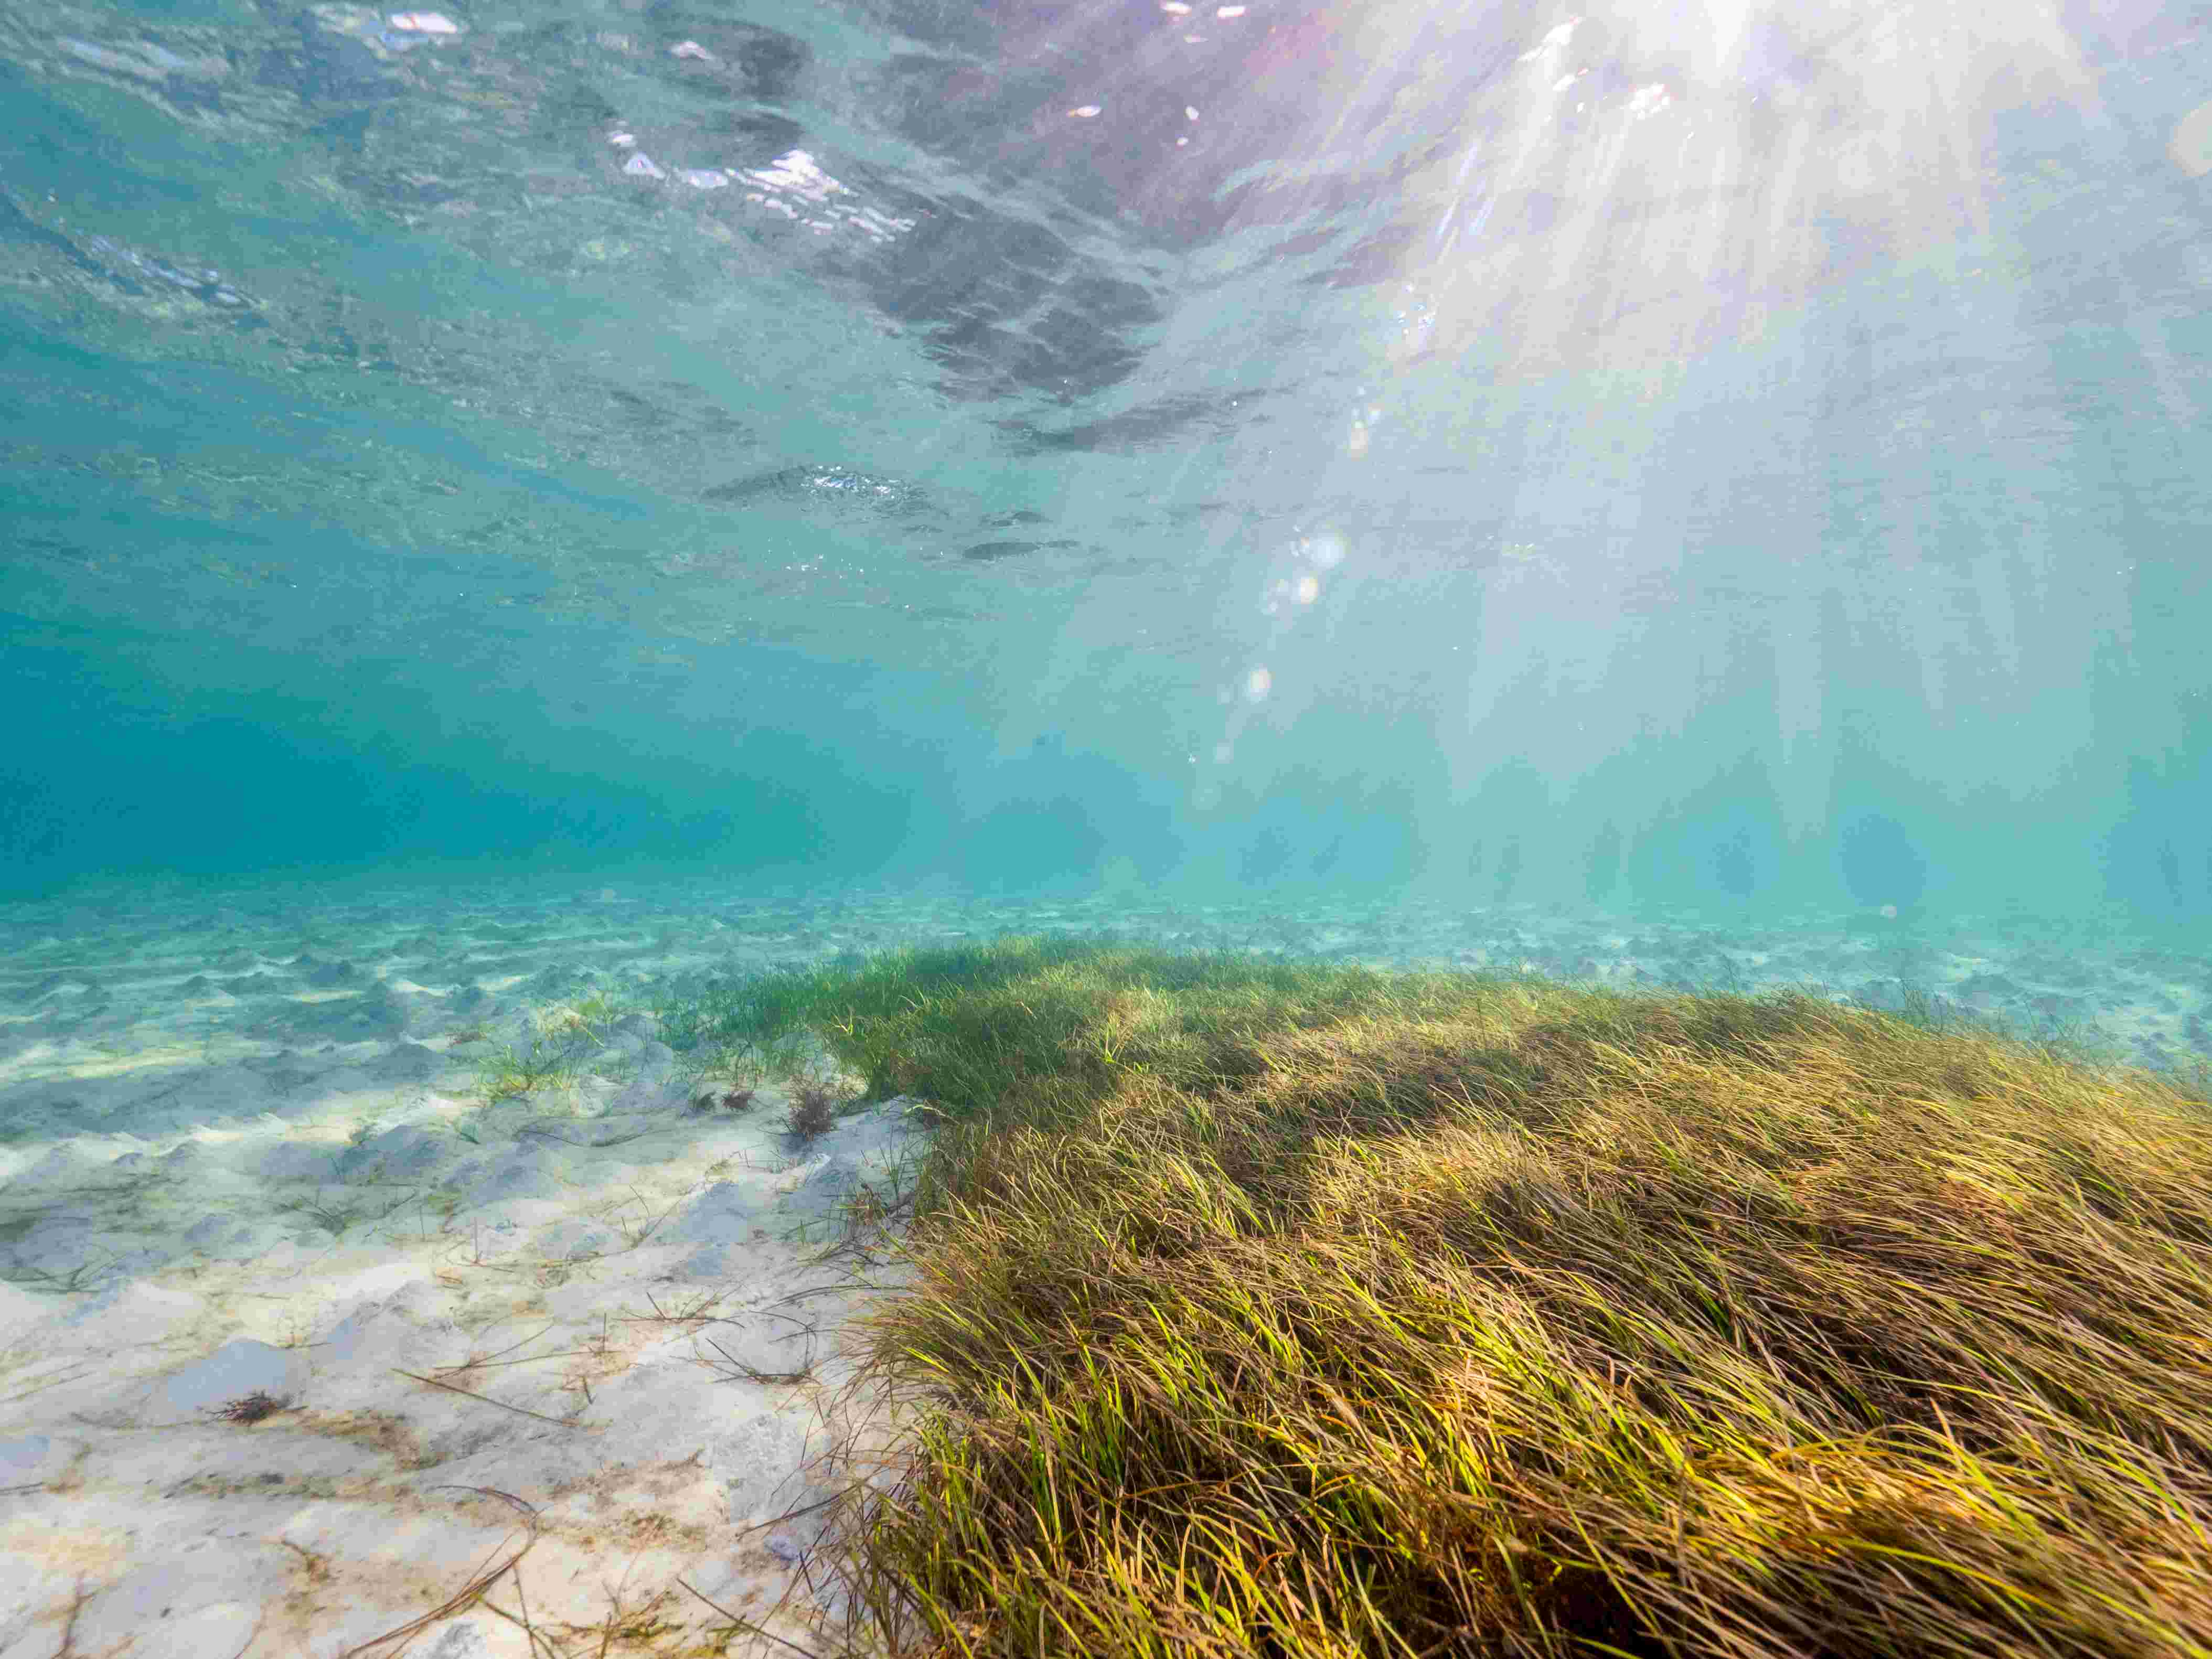
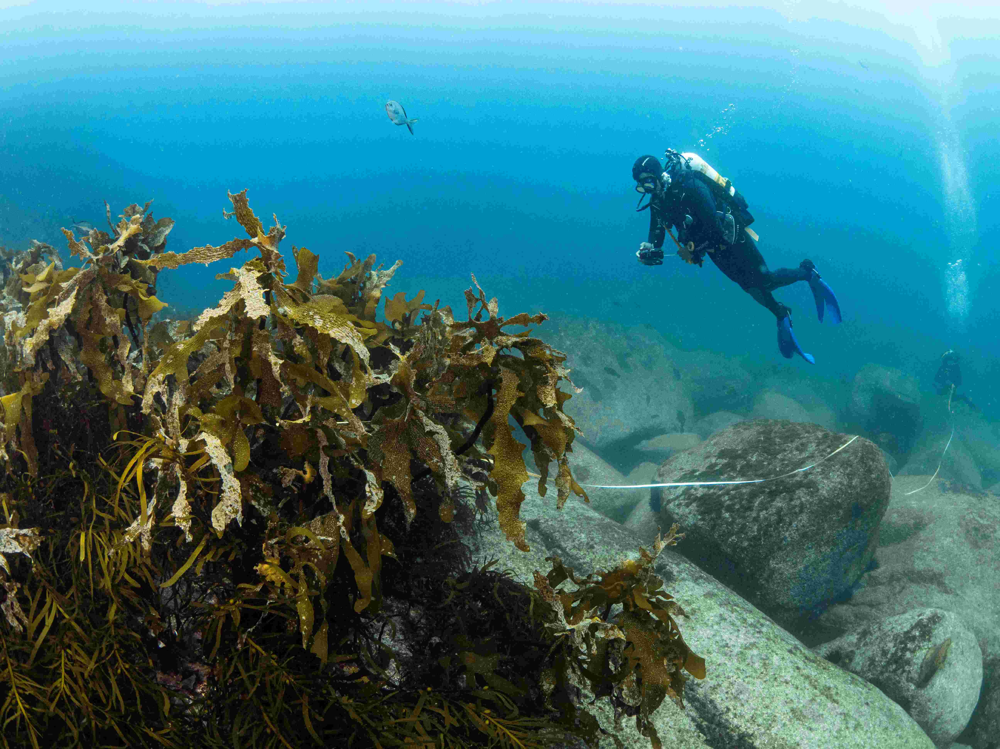


Slide 6
Learning intention
Students use the Big Fish game (as a simulation) to model adaption policies and marine management to create more resilient marine ecosystems while also providing the same or increased community and environmental benefits.
Ocean Acidification = Shows how certain species will become less abundant in our marine environments due to changing ocean pH (acidity) and what the lose of these species will mean. It provides insights into how we will need to manage these losses in the future.
Long Spined Sea Urchins Arrive = These cards show the cascading impacts that “range-shifting” species can have on marine ecosystems. They highlight the expected decline in ecosystem health, alongside the loss of a key management option. When paired with the Ocean Acidification card, students can see how pressures that seem separate can combine to create bigger, compounding effects. The scenario also makes it clear how the presence or absence of management tools changes how well an ecosystem can adapt and build resilience to climate change, while giving students early clues about practical ways to respond.
El Niño Begins = This card helps students see how a warming climate can shift weather patterns and trigger flow-on effects through marine ecosystems. It also points to a practical resilience lever: protecting big fish. When big fish are conserved, they remain a management option that can make the ecosystem more resilient. When big fish are fished out, the ecosystem becomes less resilient and recover from climate events is slow or non-existent.

Slide 7
Success criteria
By the end of the lesson, students can:
Test and evaluate management options that build resilient marine ecosystems.
Explain how society and managers should adapt their management policies and strategies, how these adaptation work, how different positive and negative actions interact, and how these interactions shape the ecosystem as a whole.
Propose a practical plan to make a local marine ecosystem more resilient to climate-driven changes. The plan must be supported by evidence and real-world examples that highlight both successes and limitations.

Slide 8
Duration
2 × 50–60 min lessons (play + analysis/write-up)
Resources
Big Fish Card Game (one deck per group of 4 if possible)
Big Fish expansion card set (if Jellyfish and Algal Blooms are to be included in the lesson)
Post-it notes for developing and refining a community or stakeholder event ideas
Materials for planning and promoting the community event
Event planning template, which also includes an optional 3-minute pitch guide (provided)

Slide 9
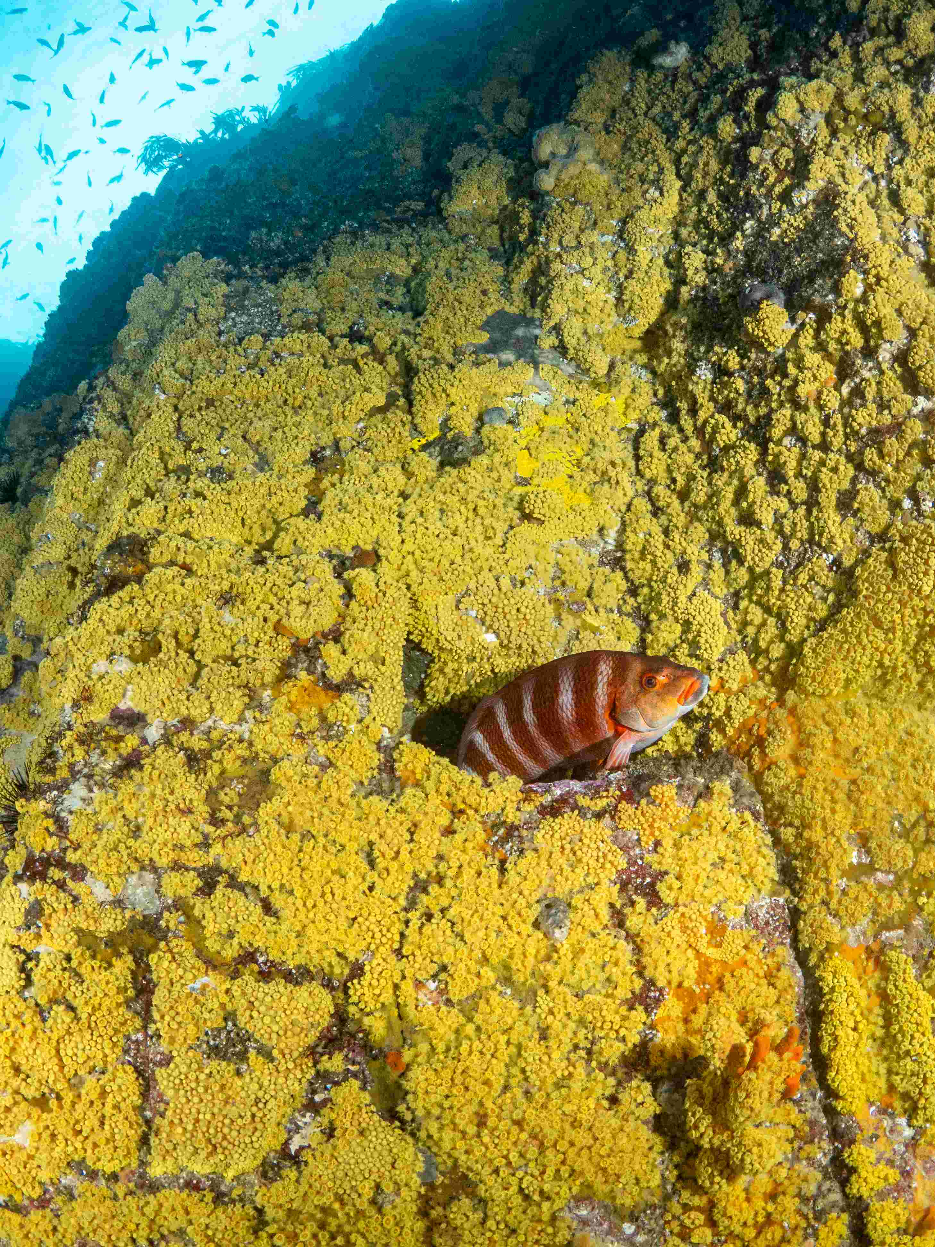
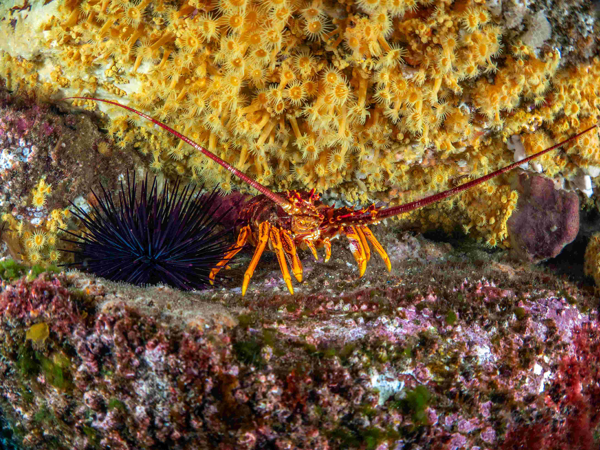
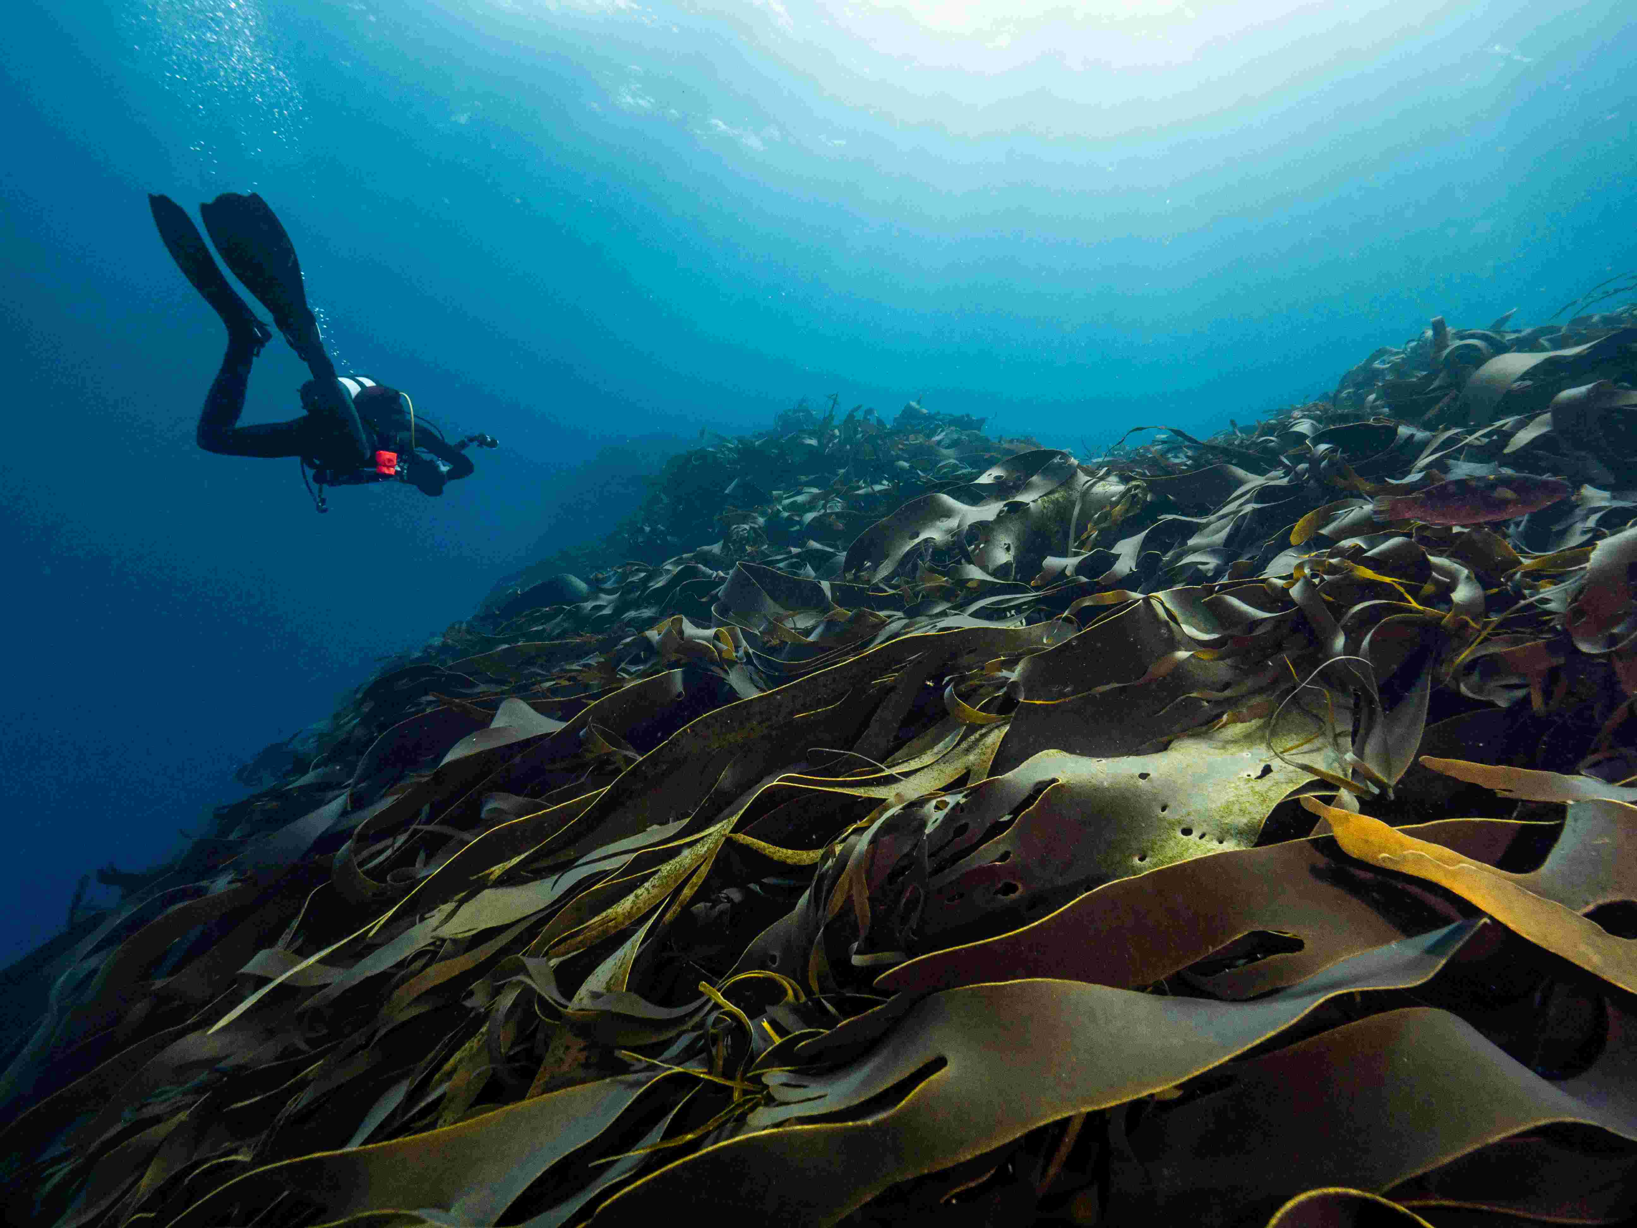

Slide 10
Assessment: design and plan an event (demo rubric included event planning template)
Design and plan an event that will engage local community or stakeholders to address one of the issues that affected your marine ecosystem in the Big Fish card game play.
Produce a 1-2 page plan for the community event, explaining the goals, target, audience, events. Use the provided “Event planning template”
(Optional) Students can also produce materials for promoting the event. This could be in the form of a poster or a 3-min pitch presentation, which could be intended as a funding pitch to a local council.
Tips:
Ensure the event is realistic and feasible while also being novel and engaging.
The event plan should explain how the event will address the issue and why it has a high chance of success.

Slide 11
Checklist for students (what the event plan should have):
I described the marine ecosystem issue and problems in my own words (heatwave, nutrients, pollution, bloom, illegal fishing).
I explored (through charts, brainstorming) at least two options to increase adaptation and resilience and understood the mechanism for each.
I used evidence from at least 5 rounds of Big Fish game (i.e. my observations) to justify my claims.
My event plan has a clear audience, actions, partners, and success measures.
My funding pitch is concise, accessible to diverse audience and clear.

Slide 12
Example scenario
A local bay is valuable both for marine creatures and ocean conservation, and for the community that relies on it for recreation and fishing. The bay is affected by heatwaves, pollution, algal blooms, and unsustainable fishing and these pressures are affecting its health.
What actions could be taken to increase the bay’s ecosystem resilience and help it cope with the growing impacts of climate change?

Slide 13
Setup
Setup is the same as for a standard Big Fish card game, except for the cards in the Event deck (end of round cards).
For the Event deck, use the three hard mode Event cards (indicated by the black bag icon atop the right side of the card). These are the El Niño Begins, Ocean Acidification and Long Spined Sea Urchins Arrive. Note, same cards also exist in non-hard mode, so replace them with the hard mode version.
Add in the Fisheries Impose Upper Size Limit and if you have the expansion card set also add the Algal Bloom and Jellyfish event cards. Shuffle these Event cards, then place the Fishing Season Closed card on the bottom on the deck. 5 rounds works well so if using the expansion consider using only 5 Event cards (including Fishing Season Closed card), although 7 rounds (6 Event cards before the Fishing Season Closed card) also works for an engaged class.

Slide 14
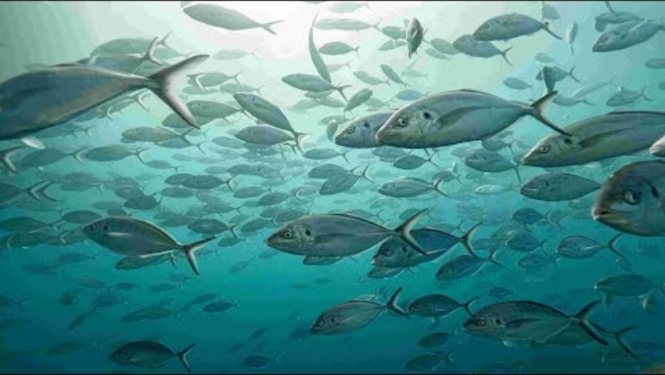
Scenario Setup Instructional Video
https://www.youtube.com/watch?v=eq0TfDlpkkU

Slide 15
Gameplay
This scenario takes the core concept and gameplay of Big Fish card game. Here is a short video explaining the full usual game play.
There is no scenario specific playthrough video, as the game as usual except for the setup of the Event cards (don’t reveal the setup of Event cards to the students!).
When playing the game, in each round students can take their turn all at once (which is faster) or in a consecutive order (which could be more interactive).
Play the game twice, if time permits, to allow students to test different adaptation strategies. This will help with their ideas and strategies needed for the assessment.

Slide 16
Playthrough example and discussion points
The Ocean Acidification event card is drawn, effectively removing all Southern Rock Lobsters. This means that no protection against Long Spined Sea Urchins is left (and that a recreational fishing favourite is no longer present).
Long Spined Sea Urchins Arrive event card is drawn but without Southern Rock Lobsters present any seaweed played is lost. Students can now see a basic ocean ecosystem connection involving the loss of one predator has a trophic effect that decreases total fish populations.
Fisheries Impose Upper Size Limit are then introduced by the next event card allowing players to spawn more fish (due to the protection of big fish).
El Niño Begins event card is drawn wiping out at least three fish from each players fishing spot. The fishing spot will recover much faster is it has enough big fish. This will also be a good time for students to start thinking about what sort of community or stakeholder engagement they could create for their assessment. For example, this could be an event that encourages protection of big fish (releasing all caught big fish) by raising awareness about their importance.
For a Year 11 class, students can be encouraged to explore the full deck to identify additional resilience options, then choose one to design an event or campaign around.

Slide 17
Debrief and reflection questions
What kind of events affected your ecosystem the most? Why?
What strategies made your ecosystem more resilient to negative events? How did they work?
How could we prevent some of these events in the first place (policies, community actions, rules and compliance)?
What ecosystem interactions did you notice?
What are examples of these events happening in real life (in Tasmania or elsewhere in Australia)?

Slide 18
Skills
Teamwork
Collaboration
Problem solving
Critical thinking
Design thinking
Assessing and evaluating options
Summarising information accurately and concisely
Science communication

Slide 19
Word List, Key Terms and Concepts
Resilience
Adaptation
Ecology
Sustainability
Ecosystem interactions
Climate change
Weather systems (El Niño)
Policies
Heatwaves
Ecosystem models
Human impact
Fishing selectivity
Cascading effects
Stakeholders
Community
Fishing pressure
Trophic interactions
Fish biology
Marine protected areas
Seaweed and kelp
Communication
Algal blooms
Invasive and range shifting species

Slide 20
Additional resources

Slide 21
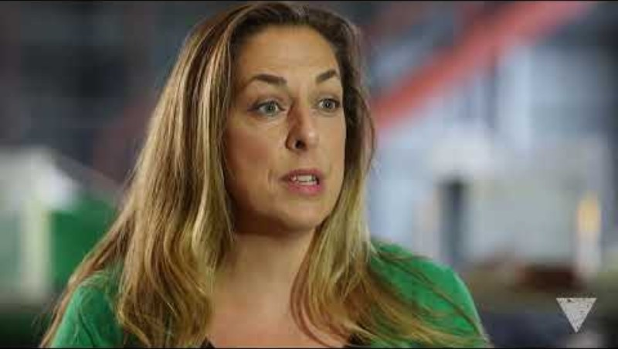
Climate change and the ocean
Warming seas are rewriting the rules underwater. Join IMAS Professor Gretta Pecl as she explains what climate change is doing to our oceans right now. A sharp, classroom friendly explanation of species range shifts, ecosystem knock-on effects, and what it means for people who rely on the sea (3 mins)
https://www.youtube.com/watch?v=uUPwGoP2bzo

Slide 22
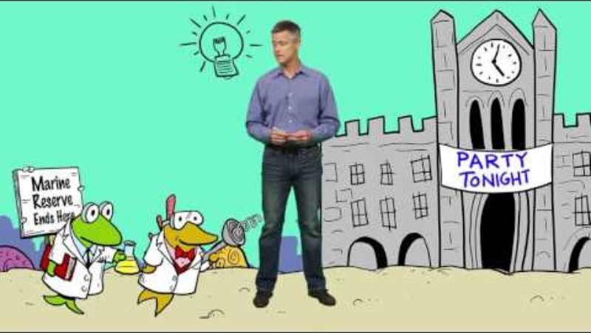
Effective marine protected areas
Meet the ocean’s “no-take zones”: highly protected marine reserves where marine life can recover, breed, and thrive. This cartoon by Pew Foundation explains why marine reserves are one of the strongest tools we’ve got for ocean health and the need to push to protect ~30% of the ocean (2 mins)
https://www.youtube.com/watch?v=w-XHDx7gKxQ&list=PLytmiH2NVuYQmjV-U_YOlztByHjEqKs4K

Slide 23
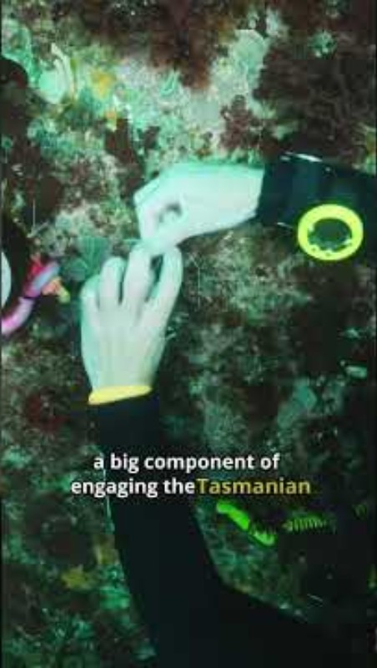
Kelp restoration and heat waves
A million-dollar effort is combining science, industry and local communities to bring Tasmania’s giant kelp forests back from the brink. A short Great Southern Reef Foundation video hit of hope and practicality: what’s driving kelp loss, and how restoration is being scaled up in the real world (1 min)
https://www.youtube.com/shorts/JDg_0dipyEo

Slide 24
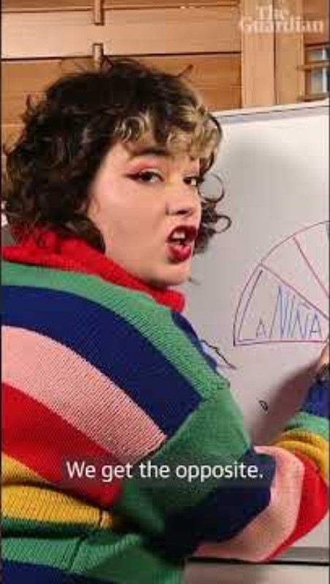
El Niño
El Niño is explained in this short clip by Guardian Australia (1 min). The video explains what El Niño actually is (and what it isn’t) in plain language. A quick climate primer for students and teachers on how ocean and atmosphere patterns can reshape rainfall, heat and extremes across Australia.
https://www.youtube.com/shorts/fc_akn2oh4A

Slide 25
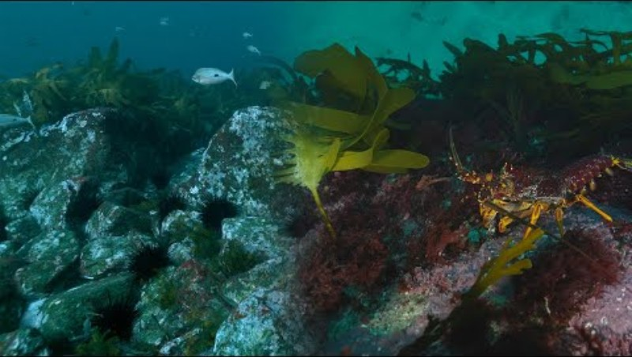
Long spined sea urchins and kelp restoration
Sea urchins are destroying kelp based ecosystems by turning underwater kelp habitats into barrens void of seaweed and fish life. IMAS scientist Scott Ling unpacks why it’s happening on Australia’s Great Southern Reef. Then he dives into the fixes: rebuilding predator power (like big lobsters) and using targeted harvest to tip reefs back toward kelp recovery (7 mins).
https://www.youtube.com/watch?v=nsLLLT908Kk

Slide 26
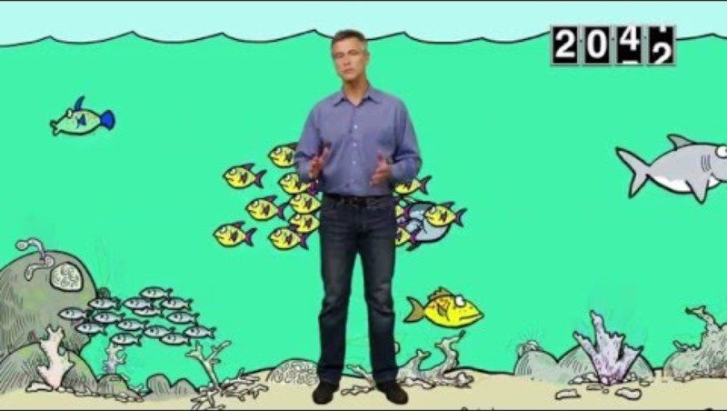
Ocean acidification - 1
https://www.youtube.com/watch?v=ogZkV-Yj7Hc
CO₂ doesn’t just warm the planet, it also changes ocean chemistry, making seawater more acidic and harder for shelled animals to build and keep their shells. This short Pew Foundation video explains how carbon dioxide emissions lead to acidification, and why it matters for food webs, fisheries, and reef health (2 mins)

Slide 27
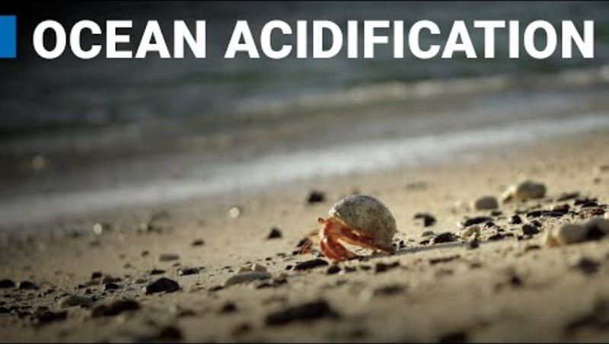
Ocean acidification - 2
https://www.youtube.com/watch?v=Nof54u0v-e8
International Atomic Energy Agency video explaining how ocean acidification works and why it is important (5 mins)

Slide 28
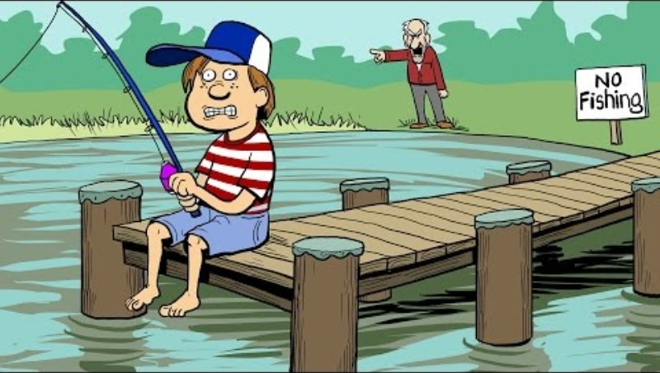
Illegal fishing
Illegal fishing isn’t “a few rule breakers” it’s organised, high-profit theft that strips oceans of fish and cheats coastal communities. This Pew Foundation cartoon explains what illegal fishing looks like, why it’s so hard to police at sea, and the ripple effects on food security and marine ecosystems (2 mins)
https://www.youtube.com/watch?v=Ypcm9B6o7pA

Slide 29
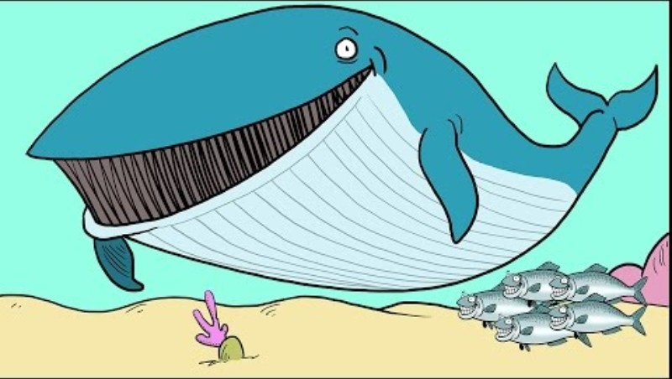
Fisheries management
Fisheries management needs to change from the question “How many fish can we catch?” to “How do we keep the whole system healthy enough to keep producing fish?” This Pew Foundation cartoon shows why managing habitat, bycatch, predators, prey, and food-web links together is the key to sustainable fisheries long-term (2 mins).
https://www.youtube.com/watch?v=fq8TKUTCXNU&list=PLytmiH2NVuYQmjV-U_YOlztByHjEqKs4K

Slide 30
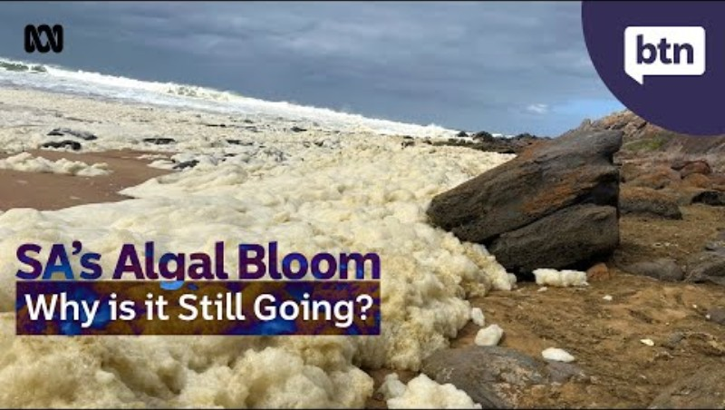
Algal blooms
South Australia’s algal bloom isn’t just about bad looking water it’s a real-time crisis affecting marine life and the people who depend on the coast. This Behind the News video unpacks what fuels a bloom, what it does to ecosystems, and why these events are becoming a big challenge (4 mins)
https://www.youtube.com/watch?v=5Yx9MyU51g4

Slide 31
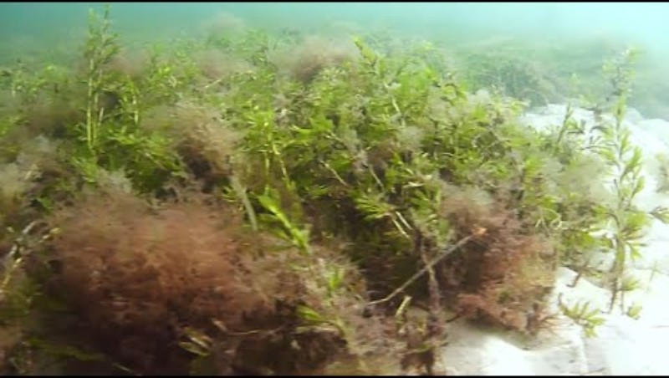
Seagrass restoration
This video to introduces habitat restoration through a real Australian case study: South Australia’s largest seagrass restoration trial rebuilding meadows off the Adelaide coast.
This video by the Department of Environment and Water (SA) will facilitate discussion on why seagrass matters and how to measure success over time (1.5 mins)
https://www.youtube.com/watch?v=JSBggmUklt8

Slide 32
Expanding into Year 11 Lessons
Instead of framing the lesson as playing a game, frame it more around the concept of using a model to understand an ecosystem
In Year 11 Biology Unit 1, students are expected to investigate ecosystems as dynamic systems (biotic + abiotic factors) and use Science Inquiry Skills: posing questions, designing an investigation, analysing data, evaluating limitations, and communicating evidence-based conclusions. So the Big Fish activity becomes the model system they run repeatedly under different conditions (treatments), then analyse like an experiment.

Slide 33
Expanding into Year 11 Lessons Examples
Year 11 students will create, evaluate and compare multiple approaches to helping increase the resilience of local marine ecosystems.
These may include combinations such as marine protected areas and seaweed planting, or single solutions such as the installation of a shellfish reef.
The assessment can then be more focused around the evaluation of options and why they chose that specific action to create and event around.
Get students to use post it notes to evaluate and talk about the management options they have and which one is best suited for the event assessment.

